Slide 1
DESIGN OF REAL TIME SPEECH RECOGNITION SYSTEM
BY: GUIDE:
DHANANJAY KUMAR KL(1PI13EC030) Dr.MANIKANDAN J
KARAN G BARHANPUR (1PI13EC039) Prof,ECE Dept
KIRAN UDAY PAIA(1PI13EC041)

Slide 2
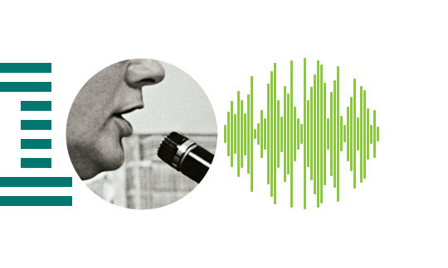
INTRODUCTION
What is Speech recognition?

Slide 3
INTRODUCTION
Also known as Automatic Speech Recognition or Computer Speech Recognition
Translation of spoken words into text
Speaker Independent
Speaker Dependent

Slide 4
OBJECTIVES
To develop an automatic speech recognizer for English language.
To critically review literature related to Speech recognition.
To implement an isolated word speech recognizer that is capable of recognizing and responding to speech.
To train the above developed system in order to make it speaker independent.
To develop real time speaker recognition system using features extraction algorithms.

Slide 5
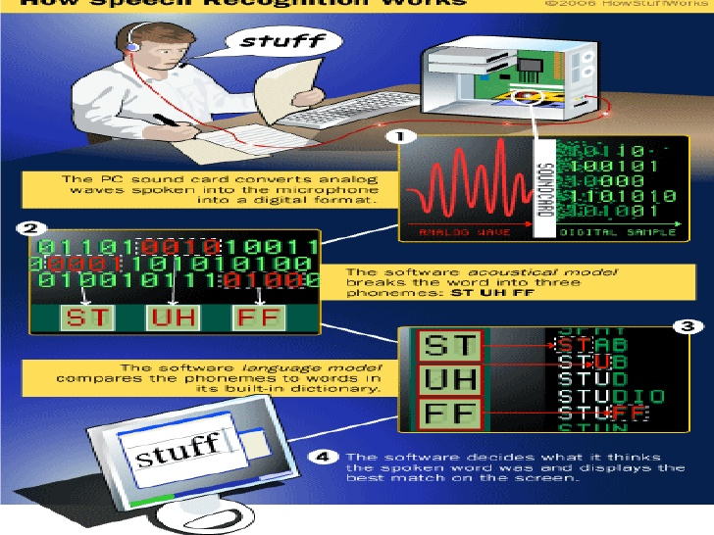
HOW SPEECH RECOGNITION WORKS

Slide 6
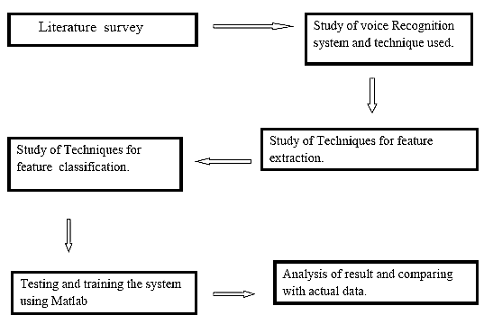
BLOCK DIAGRAM

Slide 7
METHODOLOGY
END POINT DETECTION
The implementation for the speaker verification system first addresses the issue of finding the endpoints of speech in a waveform.
This algorithm gives the entire region where speech exists in an input signal.

Slide 8
METHODOLOGY
2.FEATURE EXTRACTION
Feature extraction involves reducing the amount of resources required to describe a large set of data.
Analysis with a large number of variables generally requires a large amount of memory and computation power , also it may cause a classification problem
LPC,MFCC,LPCC

Slide 9
METHODOLOGY
3.NEURAL NETWORKS
Used to classify set of features
Veterbi Search
Confidence levels

Slide 10
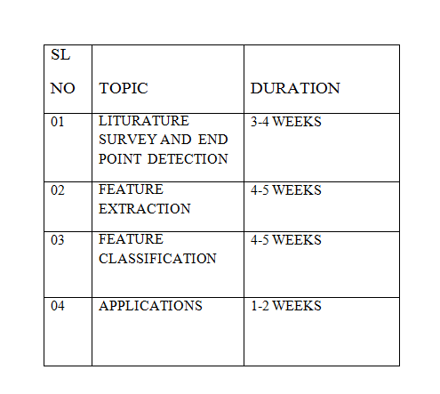
ROADMAP

Slide 11
Speech Recognition Applications:
Voice User Interfaces
Call Routing
Domestic Appliance Control
Search
Simple Data Entry
Radiology Report
Speech-to-text Processing
Aircrafts

Slide 12
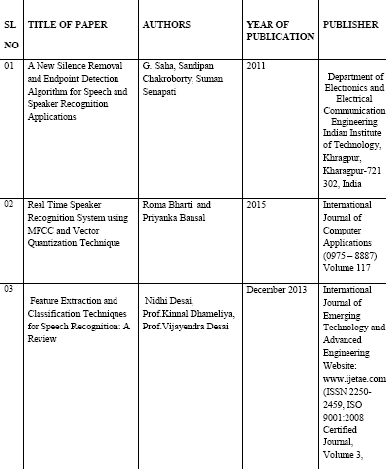
REFERENCES

Slide 13
REFERENCES
1)Deep learning approaches to problems in speech recognition, computational chemistry, and natural language text processing By George Edward Dahl A thesis submitted in conformity with the requirements for the degree of Doctor of Philosophy Graduate Department of Computer Science University of Toronto
2)Real Time Speaker Recognition System using MFCC and Vector Quantization Technique Roma Bharti Mtech, Manav rachna international university Faridabad Priyanka Bansal Mtech Manav rachna international university Faridabad
3)Machine Learning Paradigms for SpeechRecognition: An Overview Li Deng, Fellow, IEEE, and Xiao Li, Member, IEEE
4)Speech Recognition Using Deep Learning Algorithms Yan Zhang, SUNet ID: yzhang5 Instructor: AndrewNg
5)Speech-To-Text Conversion (STT) System Using Hidden Markov Model (HMM) Su Myat Mon, Hla Myo Tun
6)Speech-to-Text and Speech-to-Speech Summarization of Spontaneous Speech Sadaoki Furui, Fellow, IEEE, Tomonori Kikuchi, Yousuke Shinnaka, and Chiori Hori, Member, IEEE
7) A New Silence Removal and Endpoint Detection Algorithm for Speech and Speaker Recognition Applications G. Saha, Sandipan Chakroborty, Suman Senapati Department of Electronics and Electrical Communication Engineering Indian Institute of Technology, Khragpur, Kharagpur-721 302, India
8)Speaker Recognition Using MFCC and Vector Quantisation Geeta Nijhawan 1, Dr. M.K Soni 2
9)D.A. Reynolds, "Experimental evaluation of features for robust speaker identification," IEEE Trans. Speech Audio Process., vol. 2(4), pp. 639-43, Oct. 1994.

